Slide 1
Mini Batches
Przemysław Sekuła

Slide 2
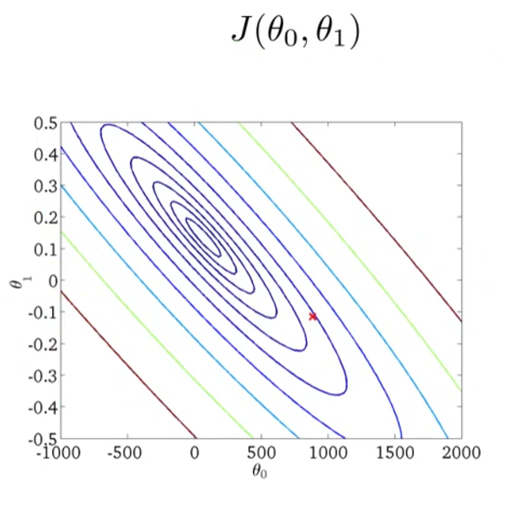
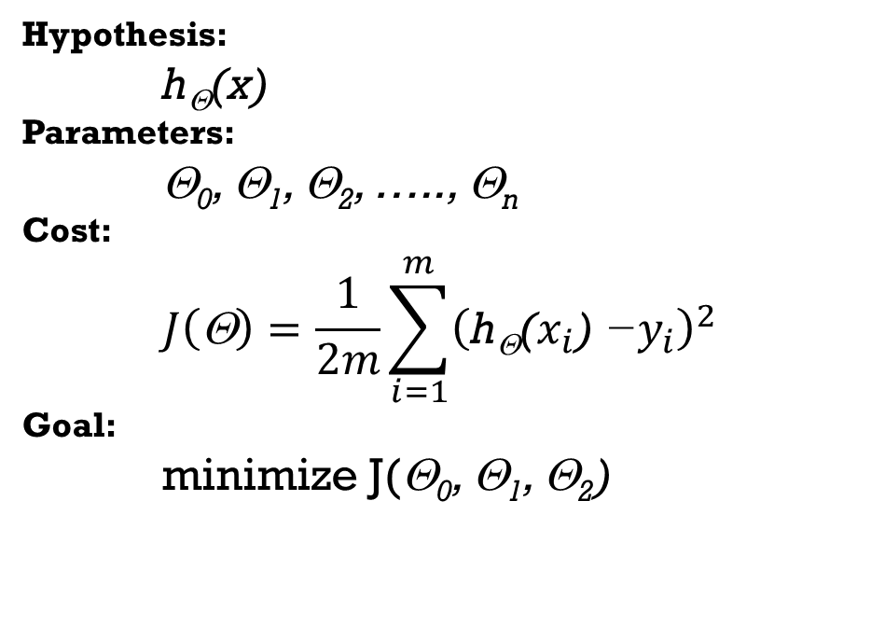
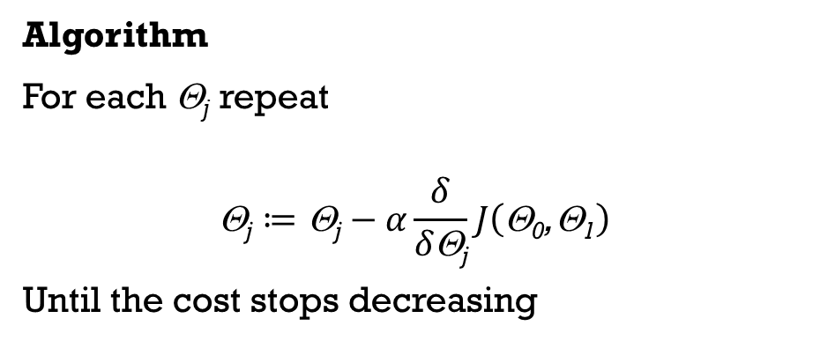
Full Batch Gradient Descent
Hypothesis:
h_{Θ}(x)
Parameters:
Θ₀, Θ₁, Θ₂, ….., Θ_{n}
Cost:
$$J\left(\text{Θ}\right)=\frac{1}{2m}\sum_{i=1}^{m}{{\left(\text{h}\text{Θ}\text{(}x_{i}\text{) −}y_{i}\right)}^{2}}$$
Goal:
minimize J(Θ₀, Θ₁, Θ₂)
Algorithm
For each Θ_{j} repeat
$$\text{}\text{j}≔\text{}\text{j}−α\frac{δ}{δ\text{}\text{j}}J\left(\text{}\text{0}\text{,}\text{1}\right)$$
Until the cost stops decreasing

Slide 3
Full Batch Gradient Descent
Hypothesis:
h_{Θ}(x)
Parameters:
Θ₀, Θ₁, Θ₂, ….., Θ_{n}
Cost:
$$J\left(\text{Θ}\right)=\frac{1}{2m}\sum_{i=1}^{m}{{\left(\text{h}\text{Θ}\text{(}x_{i}\text{) −}y_{i}\right)}^{2}}$$
Goal:
minimize J(Θ₀, Θ₁, Θ₂)
Algorithm
For each Θ_{j} repeat
$$\text{}\text{j}≔\text{}\text{j}−α\frac{δ}{δ\text{}\text{j}}J\left(\text{}\text{0}\text{,}\text{1}\right)$$
Until the cost stops decreasing

Slide 4
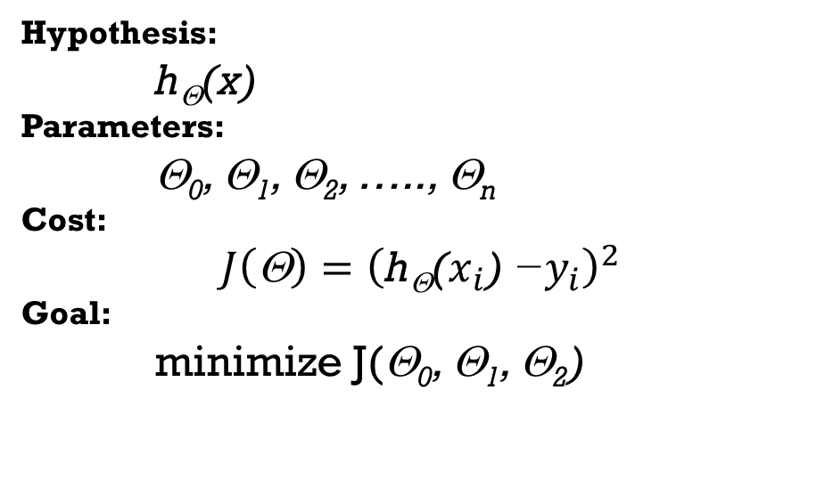
Stochastic Gradient Descent
Hypothesis:
h_{Θ}(x)
Parameters:
Θ₀, Θ₁, Θ₂, ….., Θ_{n}
Cost:
$$J\left(\text{Θ}\right)={\left(\text{h}\text{Θ}\text{(}x_{i}\text{) −}y_{i}\right)}^{2}$$
Goal:
minimize J(Θ₀, Θ₁, Θ₂)
Algorithm
For each Θ_{j} repeat
$$\text{}\text{j}≔\text{}\text{j}−α\frac{δ}{δ\text{}\text{j}}J\left(\text{}\text{0}\text{,}\text{1}\right)$$
Until the cost stops decreasing

Slide 5
Stochastic Gradient Descent
Hypothesis:
h_{Θ}(x)
Parameters:
Θ₀, Θ₁, Θ₂, ….., Θ_{n}
Cost:
$$J\left(\text{Θ}\right)={\left(\text{h}\text{Θ}\text{(}x_{i}\text{) −}y_{i}\right)}^{2}$$
Goal:
minimize J(Θ₀, Θ₁, Θ₂)
Algorithm
For each Θ_{j} repeat
$$\text{}\text{j}≔\text{}\text{j}−α\frac{δ}{δ\text{}\text{j}}J\left(\text{}\text{0}\text{,}\text{1}\right)$$
Until the cost stops decreasing

Slide 6
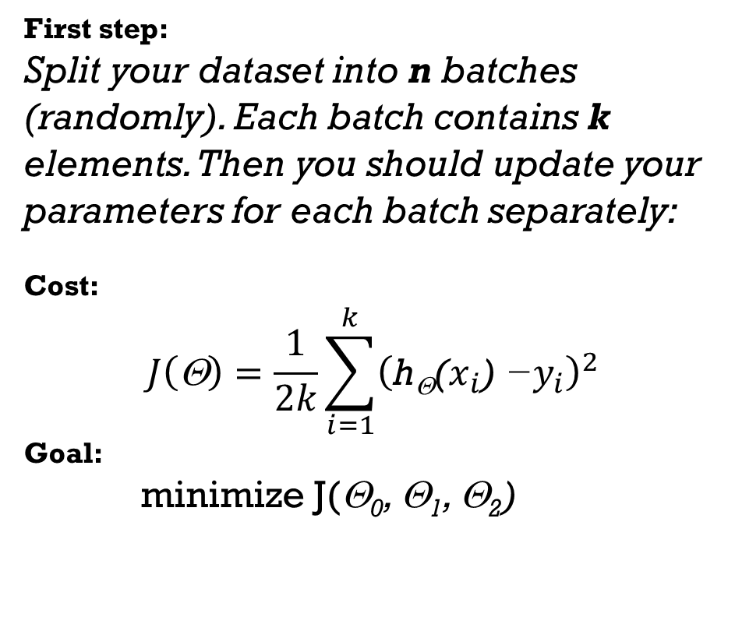
MINI Batch Gradient Descent
First step:
Split your dataset into n batches (randomly). Each batch contains k elements. Then you should update your parameters for each batch separately:
Cost:
$$J\left(\text{Θ}\right)=\frac{1}{2k}\sum_{i=1}^{k}{{\left(\text{h}\text{Θ}\text{(}x_{i}\text{) −}y_{i}\right)}^{2}}$$
Goal:
minimize J(Θ₀, Θ₁, Θ₂)
Algorithm
For each Θ_{j} repeat
$$\text{}\text{j}≔\text{}\text{j}−α\frac{δ}{δ\text{}\text{j}}J\left(\text{}\text{0}\text{,}\text{1}\right)$$
Until the cost stops decreasing

Slide 7
MINI Batch Gradient Descent
First step:
Split your dataset into n batches (randomly). Each batch contains k elements. Then you should update your parameters for each batch separately:
Cost:
$$J\left(\text{Θ}\right)=\frac{1}{2k}\sum_{i=1}^{k}{{\left(\text{h}\text{Θ}\text{(}x_{i}\text{) −}y_{i}\right)}^{2}}$$
Goal:
minimize J(Θ₀, Θ₁, Θ₂)
Algorithm
For each Θ_{j} repeat
$$\text{}\text{j}≔\text{}\text{j}−α\frac{δ}{δ\text{}\text{j}}J\left(\text{}\text{0}\text{,}\text{1}\right)$$
Until the cost stops decreasing

Slide 8
Minibatch - Example
Dataset
Your dataset contains 100,000 elements
You want to have batches with size 64 elements in batch. You split your dataset into 1,563 batches (last batch contains 32 elements)
Then you perform learning algorithm for each batch. It means that you feed your learning algorithm with 1 batch (64 elements)
Note: When you go through the entire dataset once it is called 1 EPOCH

Slide 9
Minibatch - Example
Dataset
Your dataset contains 100,000 elements
You want to have batches with size 64 elements in batch. You split your dataset into 1,563 batches (last batch contains 32 elements)
Then you perform learning algorithm for each batch. It means that you feed your learning algorithm with 1 batch (64 elements)
Note: When you go through the entire dataset once it is called 1 EPOCH
1

Slide 10
Minibatch - Example
Dataset
Your dataset contains 100,000 elements
You want to have batches with size 64 elements in batch. You split your dataset into 1,563 batches (last batch contains 32 elements)
Then you perform learning algorithm for each batch. It means that you feed your learning algorithm with 1 batch (64 elements)
Note: When you go through the entire dataset once it is called 1 EPOCH
1
2

Slide 11
Minibatch - Example
Dataset
Your dataset contains 100,000 elements
You want to have batches with size 64 elements in batch. You split your dataset into 1,563 batches (last batch contains 32 elements)
Then you perform learning algorithm for each batch. It means that you feed your learning algorithm with 1 batch (64 elements)
Note: When you go through the entire dataset once it is called 1 EPOCH
1
2
3

Slide 12
Minibatch - Example
Dataset
Your dataset contains 100,000 elements
You want to have batches with size 64 elements in batch. You split your dataset into 1,563 batches (last batch contains 32 elements)
Then you perform learning algorithm for each batch. It means that you feed your learning algorithm with 1 batch (64 elements)
Note: When you go through the entire dataset once it is called 1 EPOCH
……
1
2
3

Slide 13
Minibatch - Example
Dataset
Your dataset contains 100,000 elements
You want to have batches with size 64 elements in batch. You split your dataset into 1,563 batches (last batch contains 32 elements)
Then you perform learning algorithm for each batch. It means that you feed your learning algorithm with 1 batch (64 elements)
Note: When you go through the entire dataset once it is called 1 EPOCH
……
1
2
3
1561

Slide 14
Minibatch - Example
Dataset
Your dataset contains 100,000 elements
You want to have batches with size 64 elements in batch. You split your dataset into 1,563 batches (last batch contains 32 elements)
Then you perform learning algorithm for each batch. It means that you feed your learning algorithm with 1 batch (64 elements)
Note: When you go through the entire dataset once it is called 1 EPOCH
……
1
2
3
1561
1562

Slide 15
Minibatch - Example
Dataset
Your dataset contains 100,000 elements
You want to have batches with size 64 elements in batch. You split your dataset into 1,563 batches (last batch contains 32 elements)
Then you perform learning algorithm for each batch. It means that you feed your learning algorithm with 1 batch (64 elements)
Note: When you go through the entire dataset once it is called 1 EPOCH
……
1
2
3
1561
1562

Slide 16
MINIBATCH - SUMMARY
To perform the minibatch algorithm you need to define the size of the batch and then split the dataset into batches.
Usually you should shuffle data and reselect batches during every epoch
The larger batches mean that the computation time required for 1 epoch is usually shorter
The smaller batches mean that you will probably need smaller number of epochs to converge.
For really complicated neural networks the size of the batches may be also limited by the available memory
Typical batch sizes: 16, 32, 64, 128, 256, 512
Minibatch was developed for big datasets!

Slide 17
Minibatch in Keras
Prepare data
Create model….
Complile model….
BATCH_SIZE = 64
EPOCHS = 10
history = model.fit(train_X, train_y,
batch_size = BATCH_SIZE,
epochs=EPOCHS)

Slide 18


MINIBATCHES for IMAGES
The approach presented on the previous slide is possible if you can fit all the data in the memory.
For big datasets (particularly for images) you often cannot do it.
If you cannot do it, you should use generators!

Slide 19
Thank you Q & A

